Slide 1

POSTER PRESENTATION

Slide 2
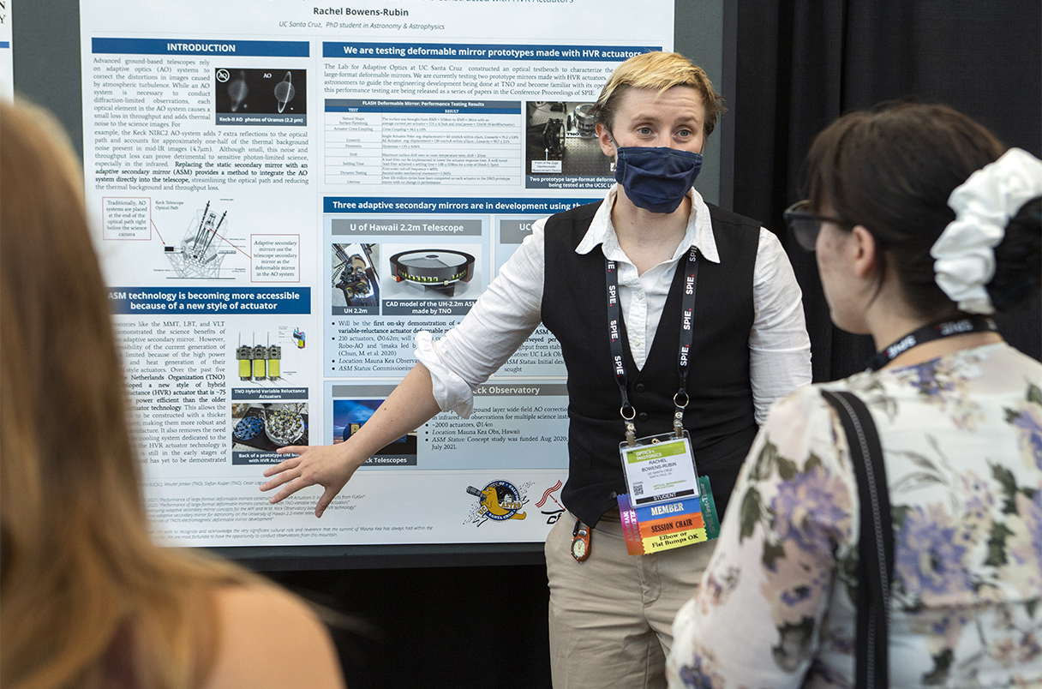
Presentation Guidelines
Length: 2-3 minutes (1 minute per person) AND question and answer
Materials: Poster (A1
size, printed)

Slide 3
POSTER: CONTENT
TITLE
Company Name
Group Members
Description: What does your company do? What products do you make? Which services do you provide?
Goals and Aims
Business plan
Target customers
Advertising strategy

Slide 4
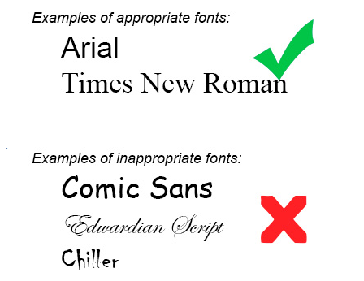
POSTER: APPEARANCE
Size: A1
Font style: DO use traditional fonts (Times New Roman, Arial) and DON’T use stylized fonts
Font size: DO use size 24 pts or higher (people should be able to read the poster from a few feet away).
DO include charts, graphics, and pictures
DO use colors to enhance your poster
Imagine the poster as a spread in a newspaper or magazine

Slide 5
PRESENTATION: SPEAKING
Class will be divided into two groups (A and B)
Group A will present first. Group B will walk around the room and listen to each presentation. Group B will take notes and ask questions.
Every group should present for 2-3 minutes (1 minute per person)
Every group should also be prepared to answer questions.
Each group will present multiple times.
The teacher will listen to each group and assign a grade.
Please DO NOT read while giving your presentation
Practice good public speaking skills: maintaining eye contact, using a clear voice, utilizing body language, etc.

Slide 6
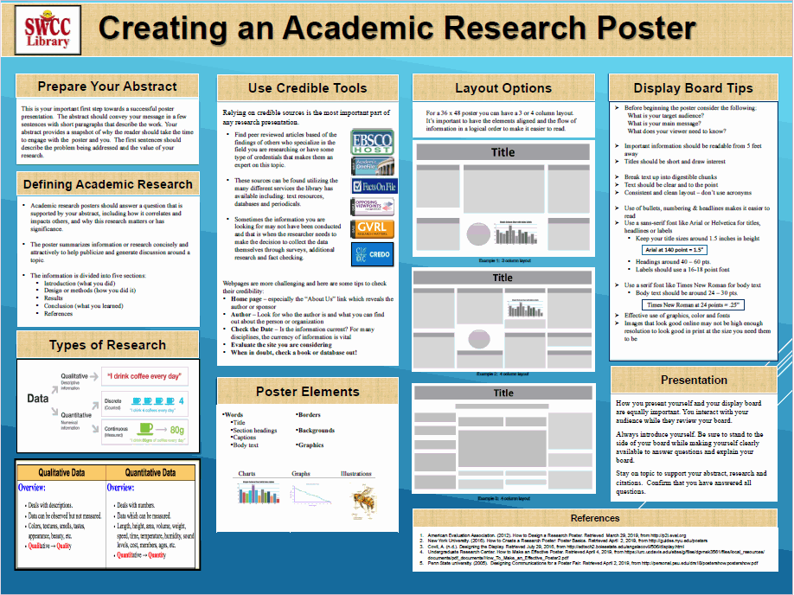

Slide 7


